Slide 1

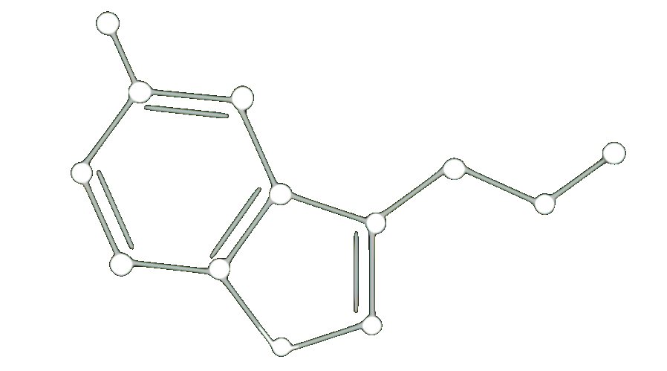

ENHANCING CHEMICAL
EXPLAINABILITY THROUGH
COUNTERFACTUAL MASKING
Łukasz Janisiów, Marek Kochańczyk, Bartosz Zieliński, Tomasz Danel
Jagiellonian University

Slide 2





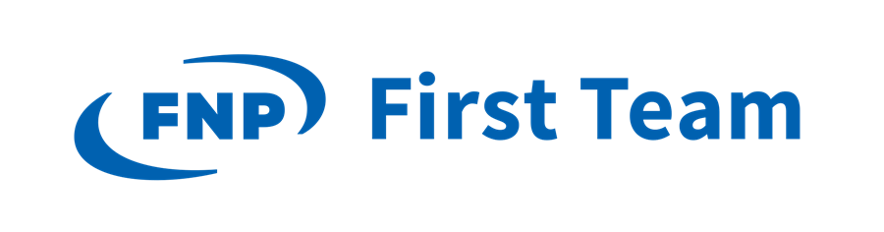

About Me
PhD Candidate (1st year) at the Jagiellonian University
Part of the ELLIS PhD Program
Supervisors:
Prof. Bartosz Zieliński (Jagiellonian University, GMUM)
Prof. Wojciech Samek (TU Berlin, Fraunhofer HHI)
Research topic: Explainable and Interpretable Machine Learning in Drug Discovery
Łukasz Janisiów

Slide 3
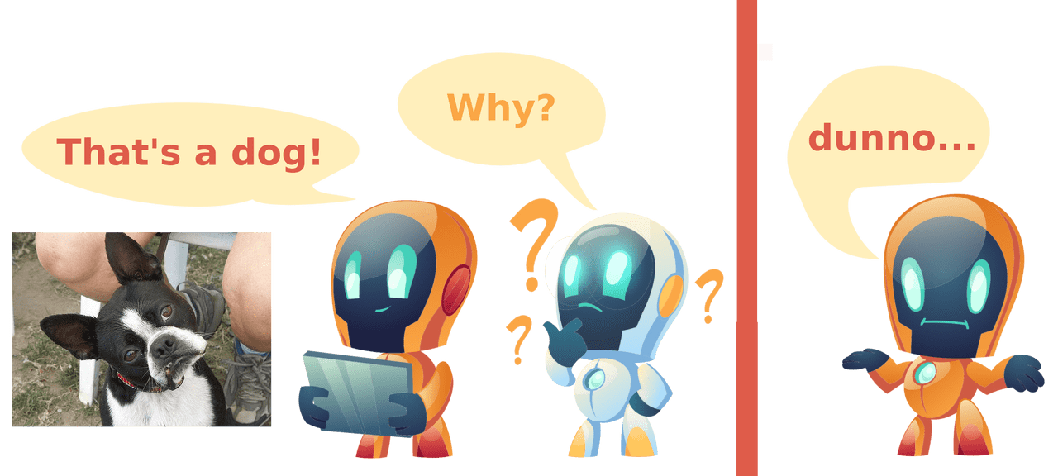
Why Explainability Matters?
Nice system, but far from perfect.
Without explainability:
Can be right for the wrong reason
Cannot be used for knowledge extraction
Source: XAI Methods - The Introduction, Kemal Erdem

Slide 4
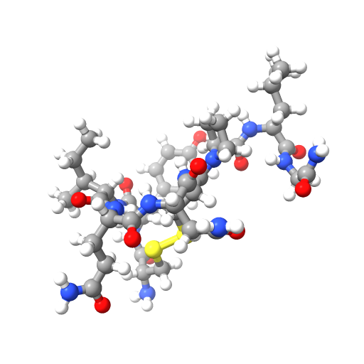
Why Explainability Matters?
Thank you…
perfect drug to cure cancer!
We need explainability:
To trust our models
To enable knowledge extraction
Source: XAI Methods - The Introduction, Kemal Erdem

Slide 5
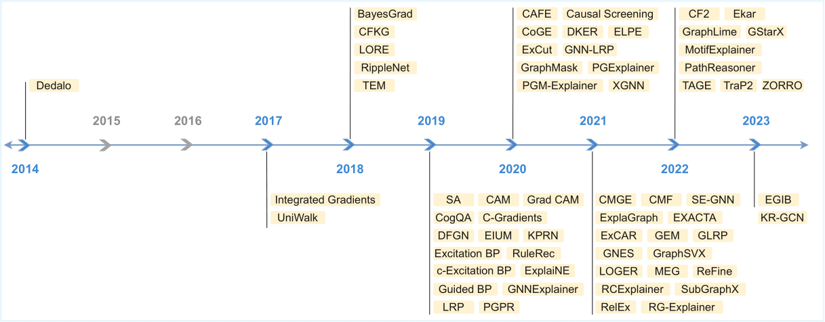
XAI for GNNs
Margarita Bugueño, Russa Biswas, Gerard de Melo.
Graph-Based Explainable AI: A Comprehensive Survey. 2024.

Slide 6
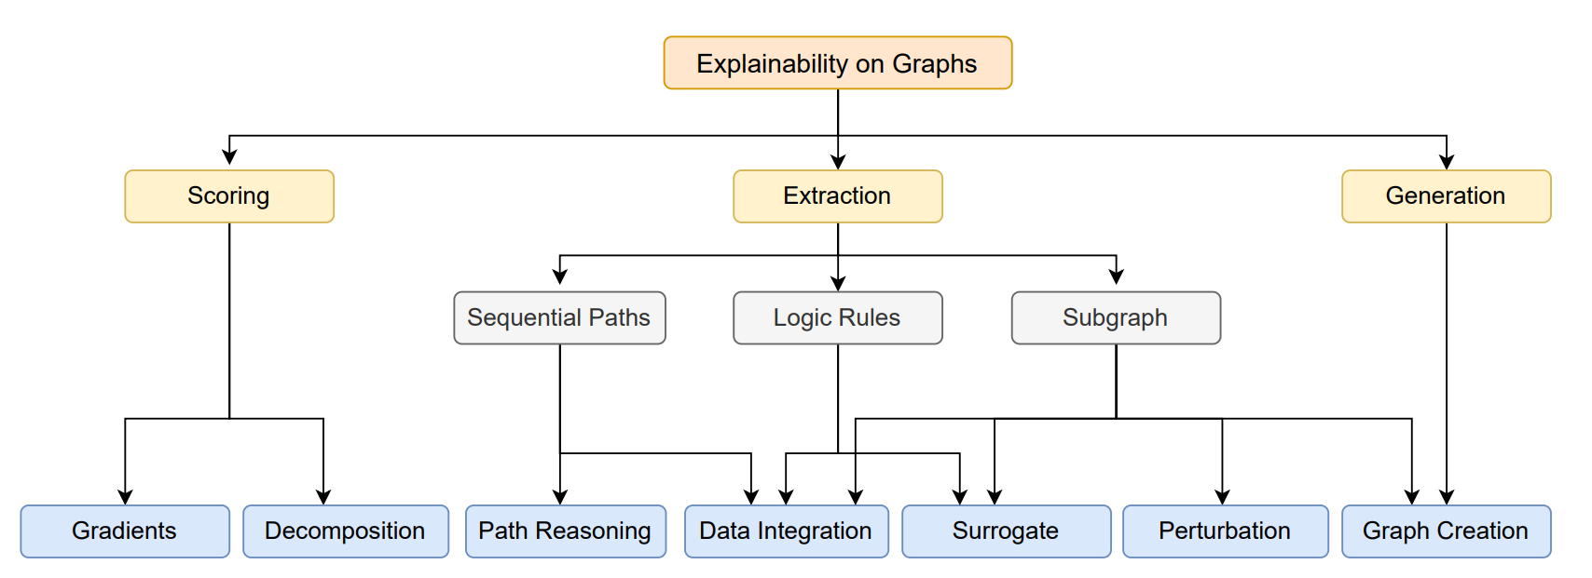
XAI for GNNs
Margarita Bugueño, Russa Biswas, Gerard de Melo.
Graph-Based Explainable AI: A Comprehensive Survey. 2024.

Slide 7
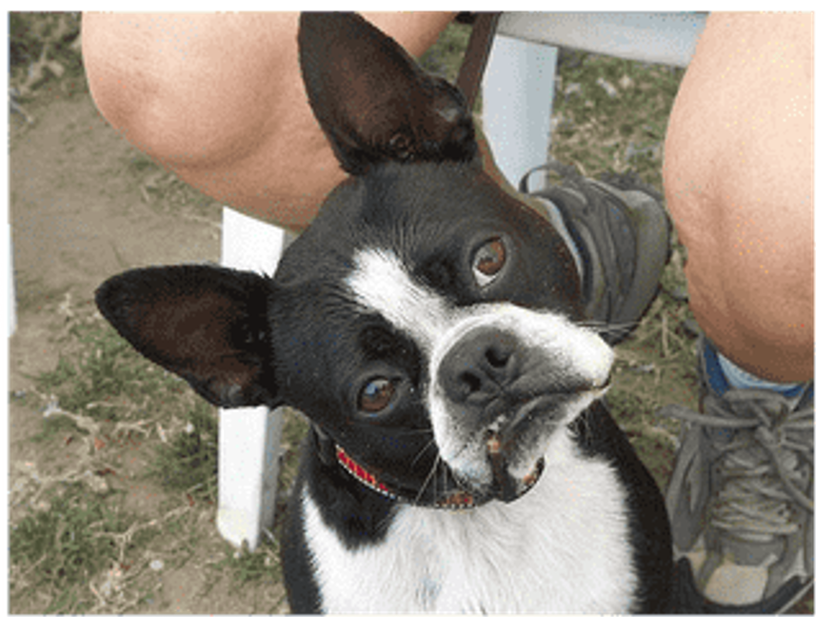
XAI – Masking
95% - dog
3% - cat
2% - cow
30% - dog
30% - cat
40% - cow

Slide 8
Why Current Masking Fails for Molecules
Fragment deletion
CHALLENGE
Two separate fragments
Naive masking
(zeroing features or deleting structures)
Molecules that are chemically invalid or physically impossible
Creates out-of-distribution (OOD) samples
Unreliable and random explanations
Zero-feature masking
Topology bias – information leakage

Slide 9
Our Solution – Counterfactual Masking
f(x') = 80% active
f(x') = 15% active
Original Molecule
Average Possible Alternative
Deleting
Generating
Averaging
f(x) = 95% active
…
f(x') = 40% active
f(x') = 25% active
Context-fragment aware generation

Slide 10
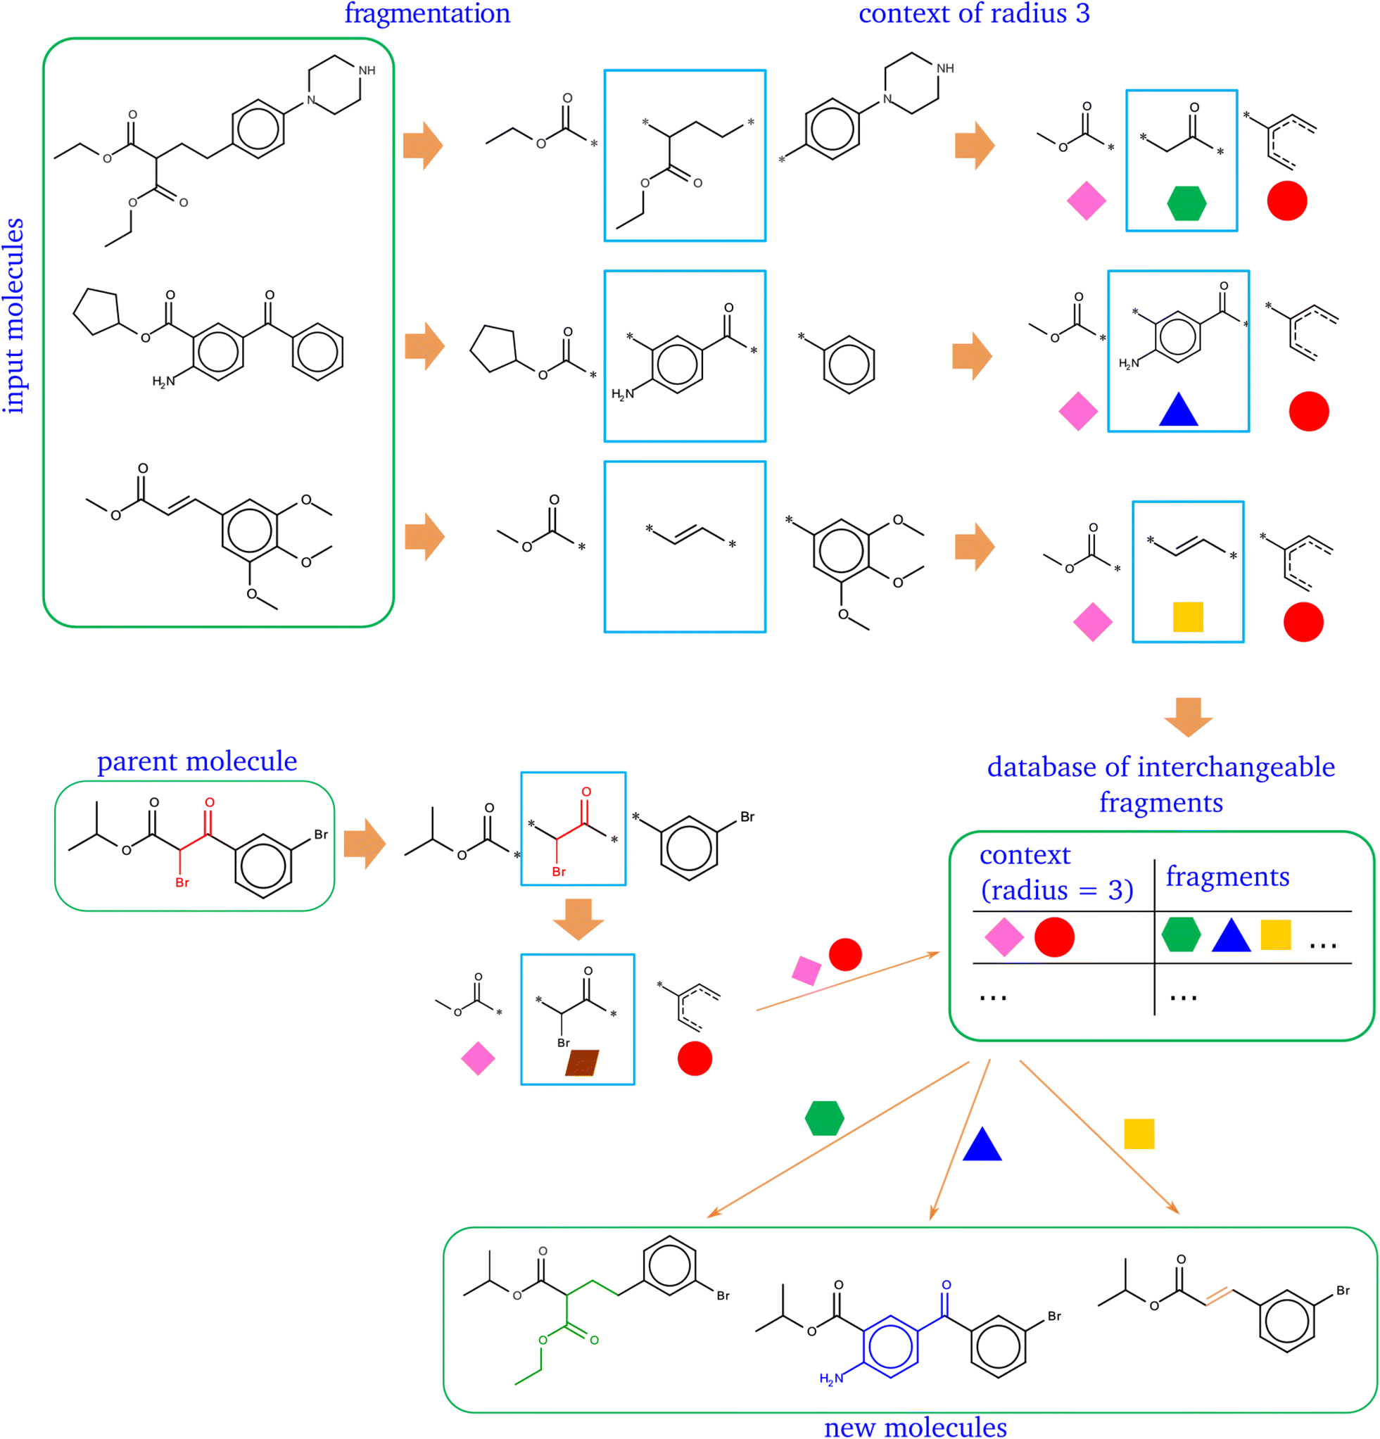
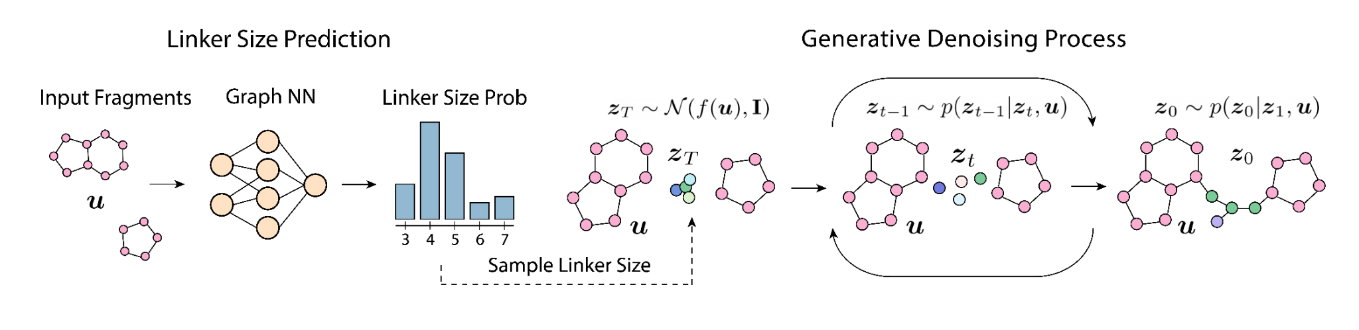
Generative Methods
Igashov, I., Stärk, H., Vignac, C. et al. Equivariant 3D-conditional diffusion model for molecular linker design. Nat Mach Intell 6, 417–427 (2024)
Polishchuk, P. CReM: chemically reasonable mutations framework for structure generation. J Cheminform 12, 28 (2020)

Slide 11
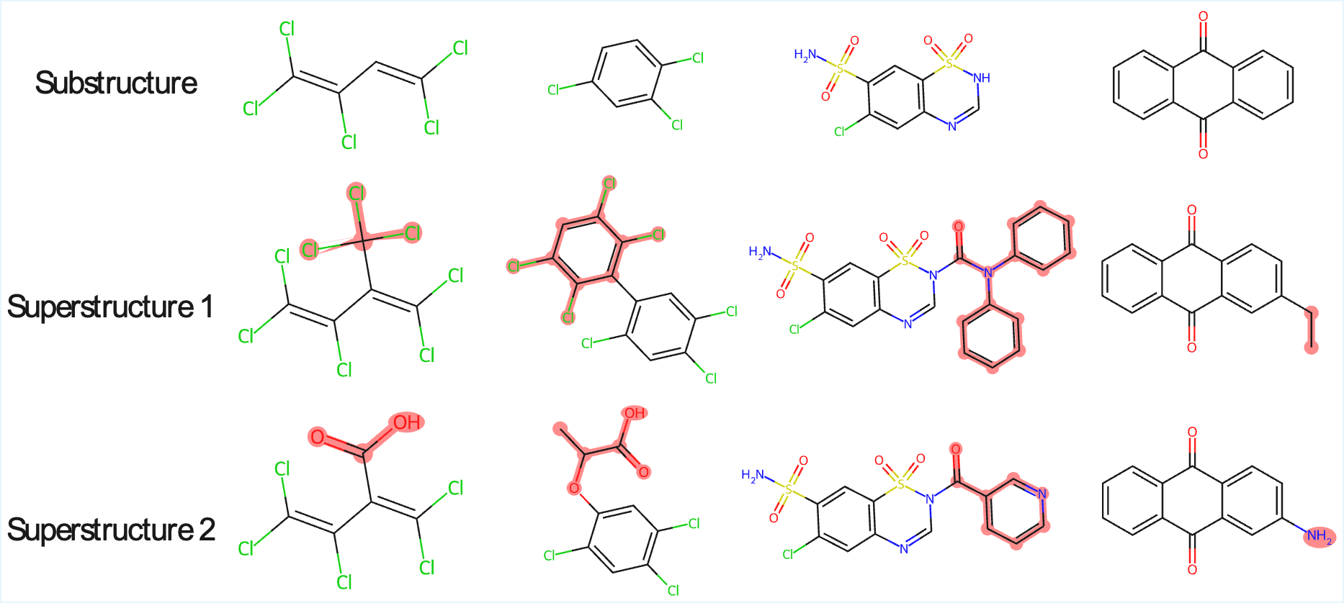
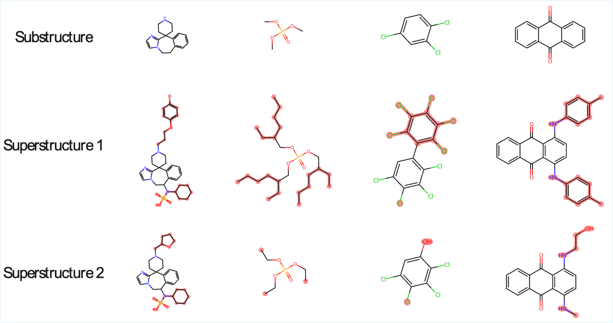
Results: How Well We Masked Fragments
An ideal masking technique should completely obscure the masked fragment, resulting in identical predictions for both molecules in the pair.

Slide 12
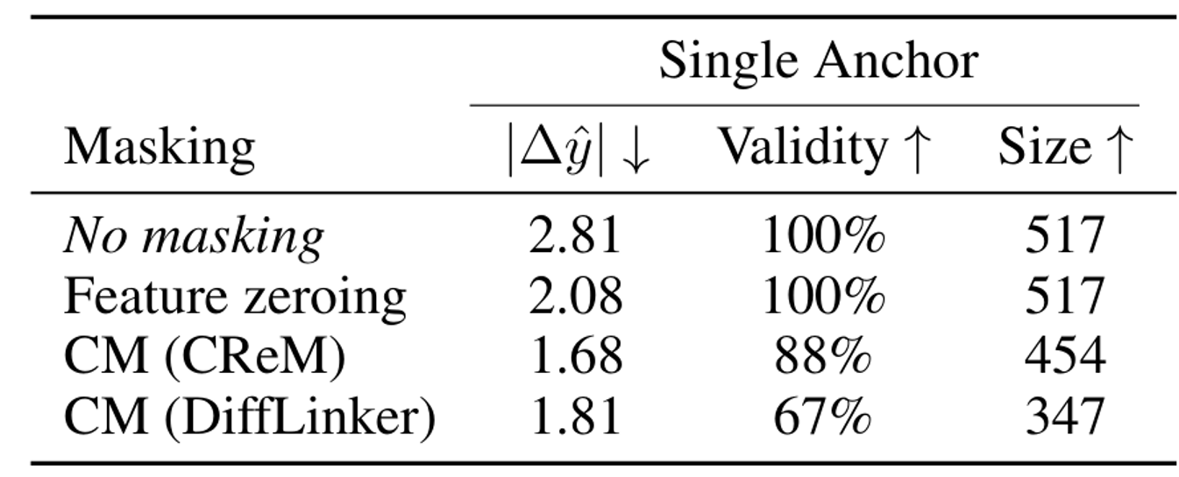
Results: How Well We Masked Fragments
An ideal masking technique should completely obscure the masked fragment, resulting in identical predictions for both molecules in the pair.

Slide 13
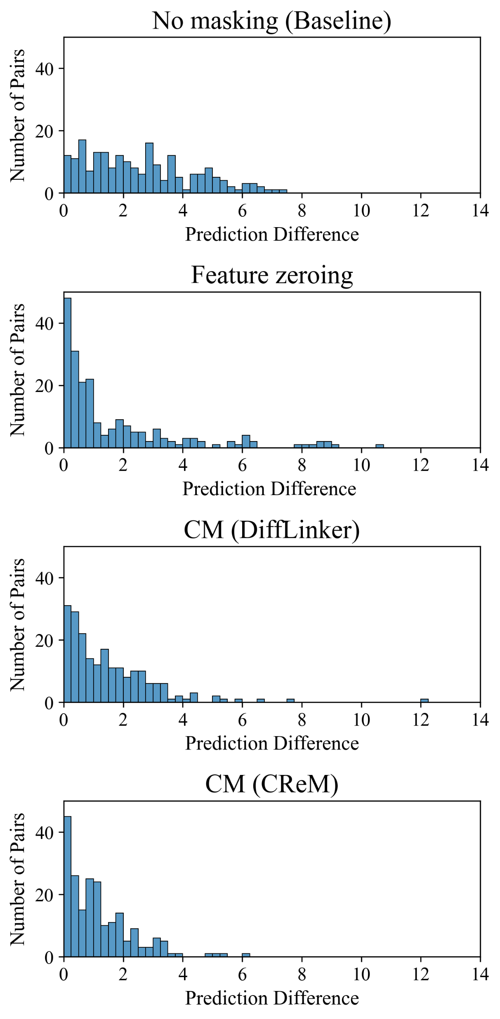
Results: How Well We Masked Fragments
An ideal masking technique should completely obscure the masked fragment, resulting in identical predictions for both molecules in the pair.

Slide 14
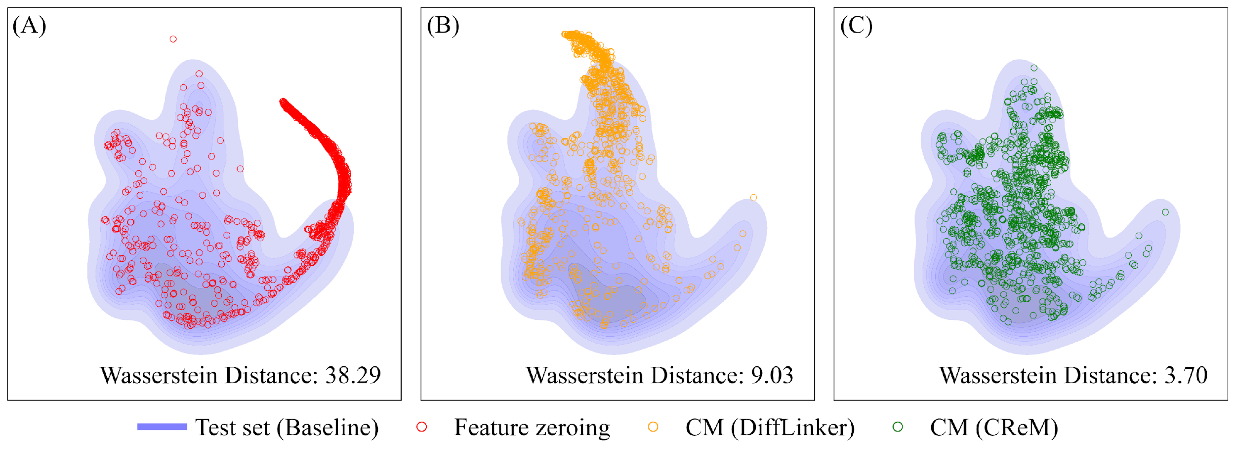
Results: How Well We Masked Fragments
Standard Masking Methods
Out-of-Distribution Samples
Counterfactual Masking
More Faithful Explanations

Slide 15
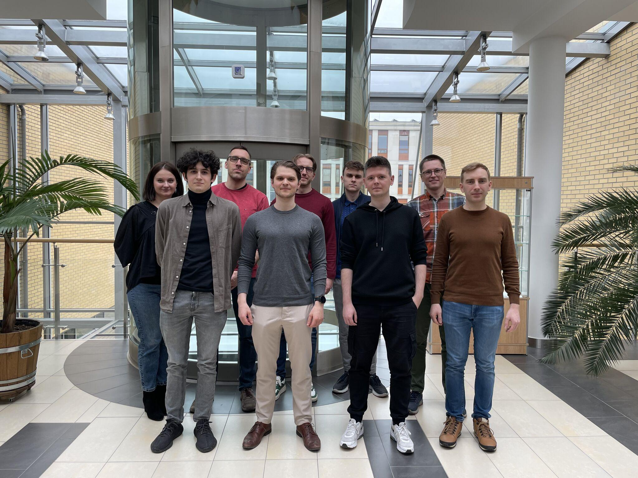



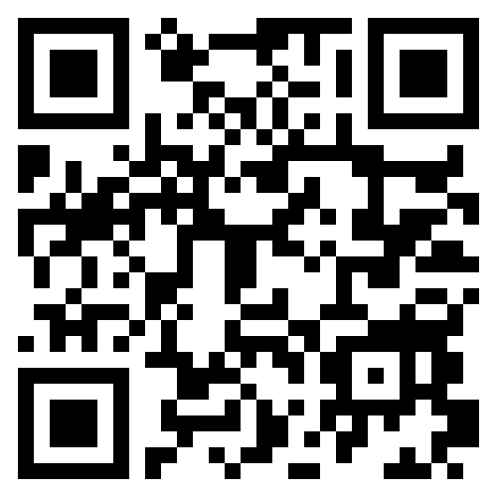

XAI Paint Team
Łukasz Janisiów
Marek Kochańczyk
Tomasz Danel
Bartosz Zieliński
arXiv
XAI Paint Team
ENHANCING CHEMICAL EXPLAINABILITY THROUGH COUNTERFACTUAL MASKING
Interpretable and Interactive Multimodal Retrieval in Drug Discovery
This study was funded by the ”Interpretable and Interactive Multimodal Retrieval in Drug Discovery” project. The ”Interpretable and Interactive Multimodal Retrieval in Drug Discovery” project (FENG.02.02-IP.05-0040/23) is carried out within the First Team programme of the Foundation for Polish Science co-financed by the European Union under the European Funds for Smart Economy 2021-2027 (FENG).
We gratefully acknowledge Polish high-performance computing infrastructure PLGrid (HPC Center: ACK Cyfronet AGH) for providing computer facilities and support within computational grant no. PLG/2025/018272.

